Slide 1


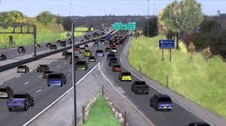
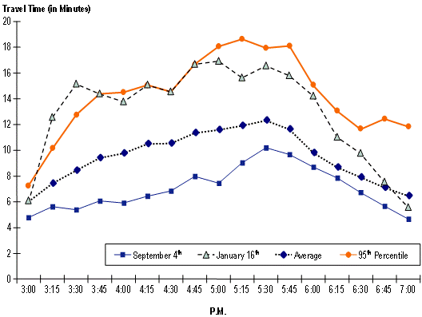
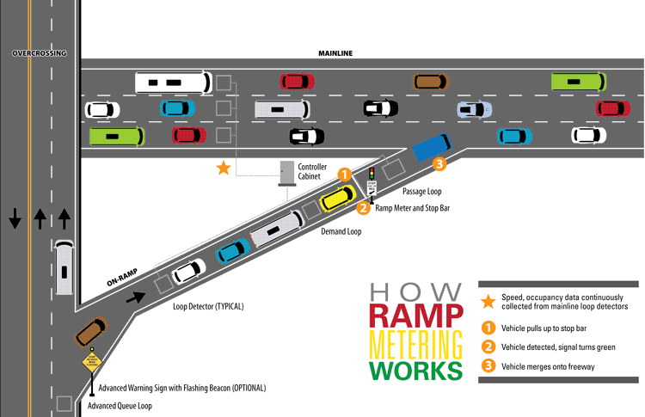
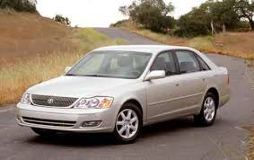
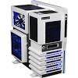
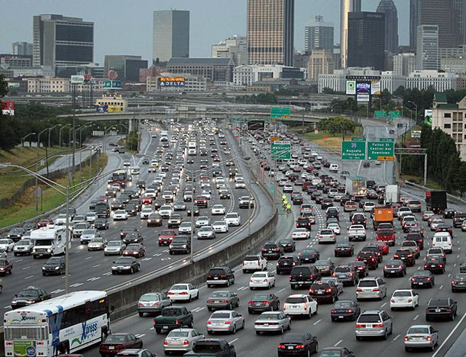
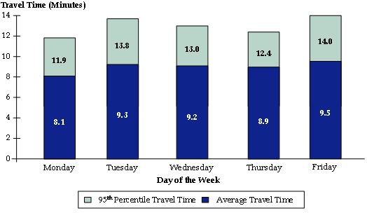
Introduction
The purpose of this simulation model is to gauge the average flow of traffic on an off ramp to a highway and how to mitigate it through a traffic light system. During different times of the day traffic flows differently and during those times a light is used to limit the incoming cars. By using the simulation model provided States will be able to eliminate traffic build up and to prevent a large amount of accidents from occurring. This model is supposed to be simple in order to focus on developing an actual traffic system that is cost efficient and effective.
Conclusions
We found that between the hours of 4PM and 6PM traffic was the heaviest between exits 1 – 9 when heading northbound. Southbound traffic was the heaviest during 6AM - 8AM.
During 2PM we noticed that cars would start backing up at a certain area which would affect cars down the line later on thus causing the traffic to occur.
During traffic we noticed it took an average of 8.6-11.3 minutes longer to get to our destination.
Though we did several rides down 75 we never rode down during the weekends as we feared mixed results during those times could affect the average
Though we did not test all possible occurrences (holidays, summer, etc.) we are certain that our model shows an accurate representation of most days down an average highway and the systems needed on the off-ramps to allow for incoming traffic to come in safe and at a steady rate.
Methods
Observed Interstate 75 at several spots during different parts of the day.
Observed the different vehicles that came in and how vehicles would affect traffic control.
After each ride down Interstate 75 wrote down time it took during that part of the day, what vehicles we saw the most, and if ramp meter lights were active during car travel.
Materials
Toyota Avalon 2000 – used to move up and down 75
Laptop – used to run simulation model before, during, and after the change in traffic
Desktop – used the same as laptop but a different environment and changed times to match varying results
Notes:
Copyright Colin Purrington (http://colinpurrington.com/tips/academic/posterdesign).

